Slide 1
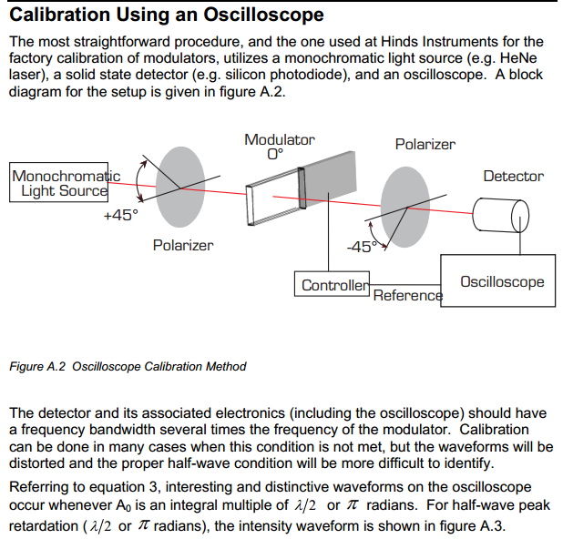
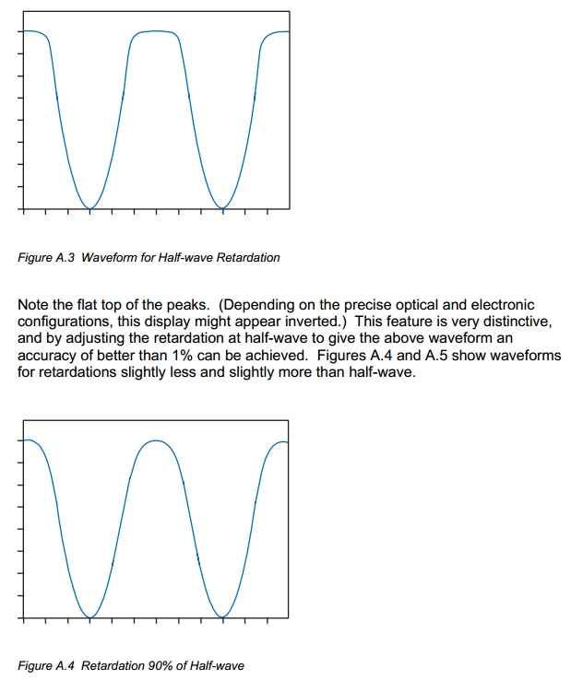
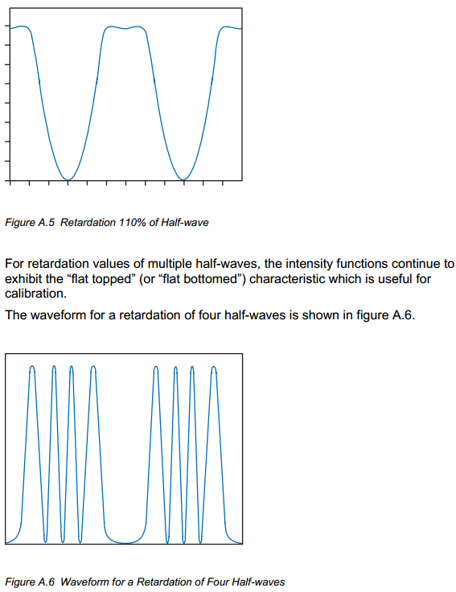
PEM checking method used
I checked the PEM following the method below, which is in PEM user manual.

Slide 2
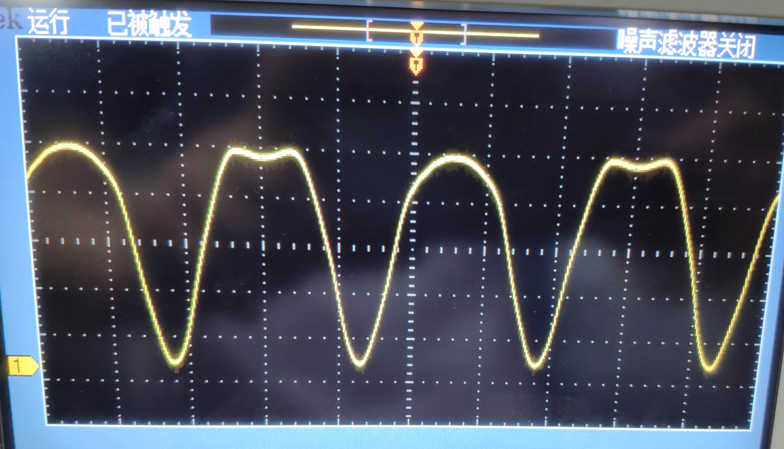
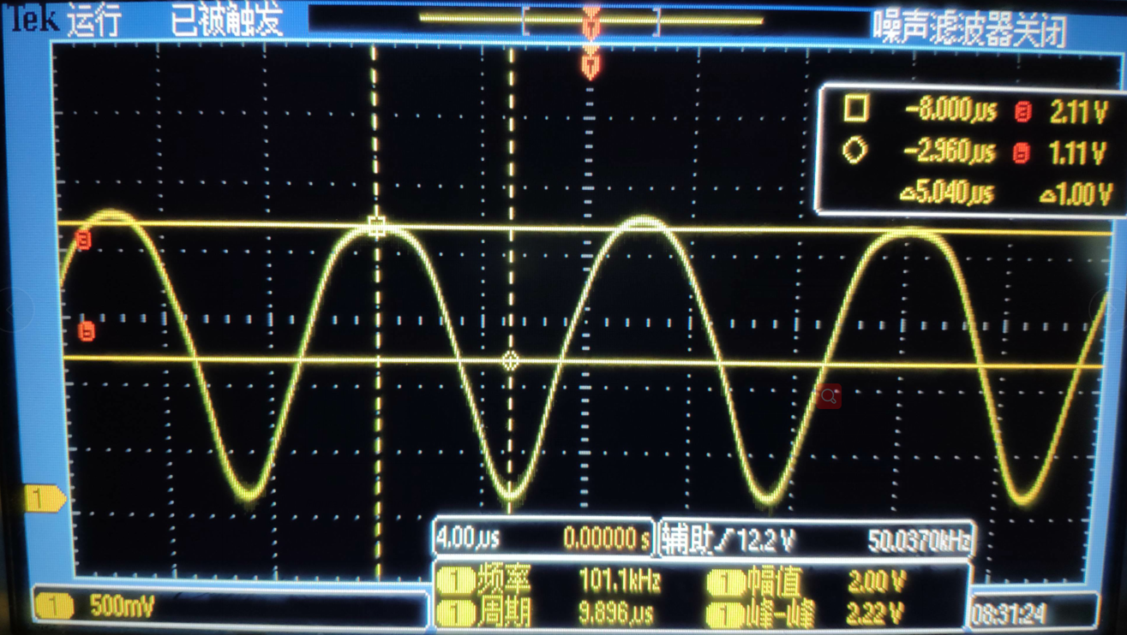
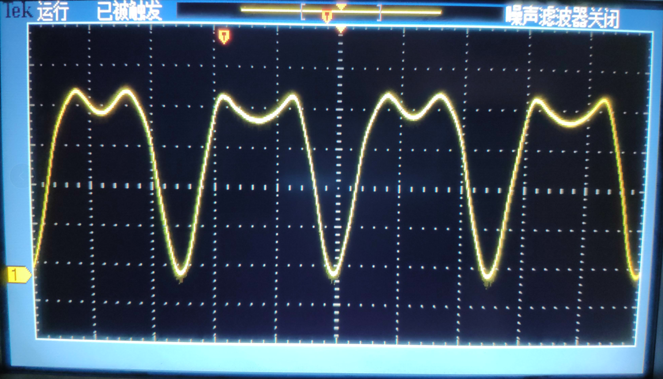
Waveform observed
When δ = 0.5 λ, there is a pit while the neighbor is a hump.
When δ = 0.4 λ, the two wave peak have distinct different height.
When δ = 0.4 λ, the two peak are also deferent.

Slide 3
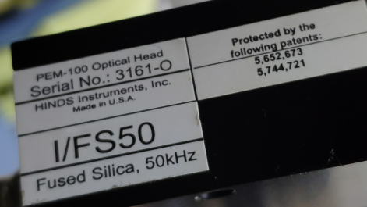
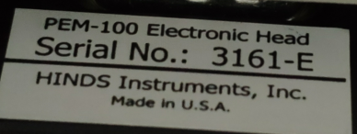
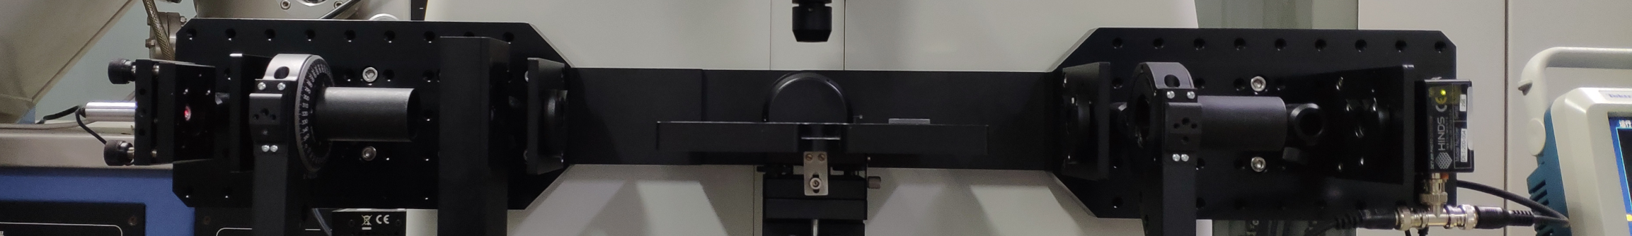
Optical components used
PEM-100，detailed information are as follows：
The light source is a lasing diode(Thorlabs inc. CPS635R), whose wavelength was measured and set to PEM controller.
The polarizer and analyzer are Glan-Thompson Polarizers(Thorlabs inc. GTH10M-A).
The detector model is DET-200-004, Hinds inc.
Photo of the structure：
light source
polarizer
PEM
analyzer
detector
diaphragm
diaphragm
diaphragm

